Slide 1
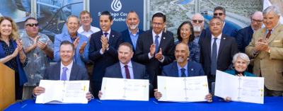
SDCWA v. Metropolitan, et al.
MWDOC Board Meeting
06.18.2025

Slide 2

Settlement Background
    The settlement ends the 15-year legal dispute over rates and the price term of an exchange agreement between MWD and SDCWA
    Starting in 2010, SDCWA repeatedly challenged the price Metropolitan charged for the exchange water
    How the exchange works: Colorado River water is provided to Metropolitan at the Colorado River and, in exchange, Metropolitan delivers the same quantity of its water to SDCWA
SDCWA’s Colorado River water is from two sources:
  Purchases from IID
  Metropolitan assigned rights to SDCWA water conserved by the lining of the All-American and Coachella canals.

Slide 3
Exchange Agreement
Price Term
    Previous Agreement
      Unit price tied to MWD transportation rate elements
      Equivalent to MWD’s generally applicable rates for conveyance adopted “pursuant to applicable laws and regulations”
    New Agreement
      Fixed unit price at specified $ amount
      10-year price schedule, escalated at 4.6% average annual increase through 2034
        2025: $622/AF
        2034: $930/AF
      Neutral index for escalation beyond 10 years

Slide 4
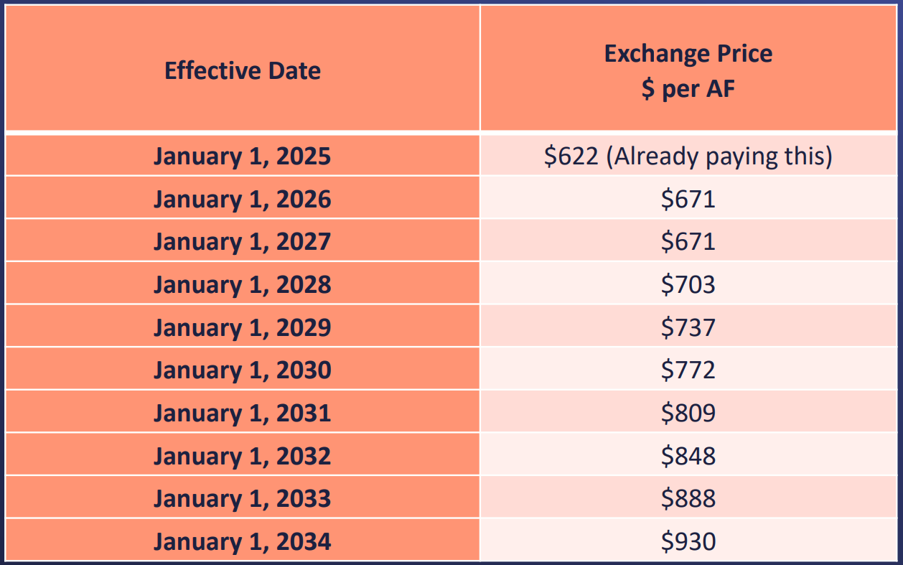
Exchange Agreement Price for CYs 2025 – 2034
Years 11 through end of term:
Price per AF adjustment per Consumer Price Index for All Urban Consumers (CPI-U) for water and sewerage, published by the U.S. Bureau of Labor Statistics

Slide 5
Exchange Agreement
Revenue for Metropolitan
    Previous Agreement
      All volumetric unit price for water exchanged
    New Agreement
      Minimum annual payment for a fixed amount
        Beginning Jan. 1, 2026 – SDCWA to pay minimum Exchange Unit Price for 227,000 AF each year regardless of amount of water actually exchanged
      Fixed amount billed in 12 equal installments
MWD Benefit
New Fixed Revenue

Slide 6
Exchange Agreement
Delivery Schedule
    Previous Agreement
      Deliveries in 12 equal installments
    New Agreement
      SDCWA has the flexibility to take deliveries as needed and as operationally feasible for MWD and SDCWA
SDCWA Benefit
Delivery Flexibility

Slide 7
Exchange Agreement
Agreement Term
    Previous Agreement
      Term for IID Transfer Water ends in 2047
    New Agreement
      Potential for automatic extension to match IID Transfer Agreement extension.
        Automatic extension, unless: Amount of transfer is reduced by more than 50,000/AF
        Note: The term of the Exchange Agreement for canal lining water remains through 2112

Slide 8
Exchange Agreement
SDCWA Transfers to Benefit Service Area
    Previous Agreement
      All IID conserved water transferred or canal lining water allocated to SDCWA will be made available for exchange
    New Agreement
      SDCWA may transfer water as follows:
        First Right of Refusal to MWD Member Agencies
          Price to be negotiated (nothing else changes)
        Second Right of Refusal to MWD
          May transfer IID and/or canal lining water to MWD
          Price set at Melded Price of IID and Canal Lining Water Cost

Slide 9
Overview of Other Terms
    Any future challenge by SDCWA of any acts or omissions shall not include any claim by SDCWA that Metropolitan is required to and/or has failed to determine “Offsetting Benefits” in connection with:
      any of its prior rates
      and/or that Metropolitan is required to and/or has failed to apply “Offsetting Benefits” to the Exchange agreement
      including the price for any water delivered under the Exchange Agreement through the Termination Date of the Exchange Agreement
Dismissals:
  Pending cases will be dismissed within 21 days of agreement, with prejudice, including all complaints, cross-complaints, claims, and cross-claims, and the cases pending in the Court of Appeal
Notes:
Have Christine say this slide….

Slide 10
Overview of Other Terms
    Water Ownership - Clarified further nature of exchange transaction by confirming MWD owns the water when Made Available at Lake Havasu.
    Waivers and Releases - SDCWA and Metropolitan each release and waive all claims, whether known or unknown
    Payment to MWD – SDCWA to pay attorneys’ fees and costs for 2014-2018 cases ~ $3.77 million within 21 days of filing of dismissals
    The Parties agree to meet every five years during the term of the Agreement to discuss ongoing implementation of the Agreement
    This does not create a unilateral right of either party to an amendment or modification of the Agreement

Slide 11
MWDOC’s Observations on
Long Term Benefits
    Metropolitan
      Predictable Fixed Revenue
      Billed in equal installments
      Lower risk of future legal challenges to MWD’s rate structure
      Help with future Colorado River AF contributions (post-2026 guidelines)
      MWD MAs and/or MWD benefit from access to the SDCWA surplus water
    SDCWA
      Rate predictability
      Operational Flexibility when taking deliveries
      Allows SDCWA to raise additional revenue from selling surplus water MWD MAs and/or MWD
      Ability to engage in regional decisions without concern for financial impact
Settlement is leading to more productive discussion in the Board Room and amongst the MA GMs

